Slide 1

Velti for Vodafone
Campaign Management Process
Proprietary Notice
This material is proprietary to Velti and Affiliates. It contains trade secrets and confidential information which is solely the property of Velti and its Affiliates. This material shall not be used, reproduced, copied, disclosed, and transmitted, in whole or in part, without the express consent of Velti. © 2020 Velti. All rights reserved.

Slide 2
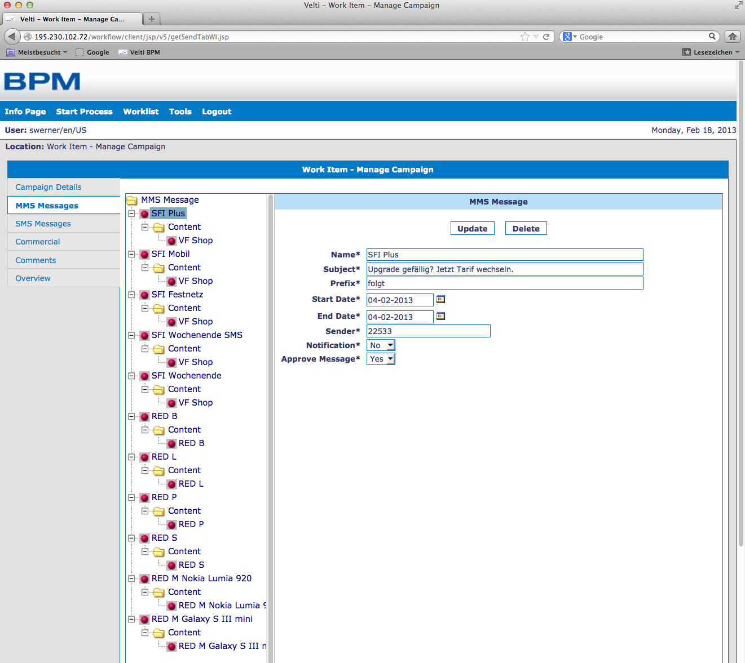
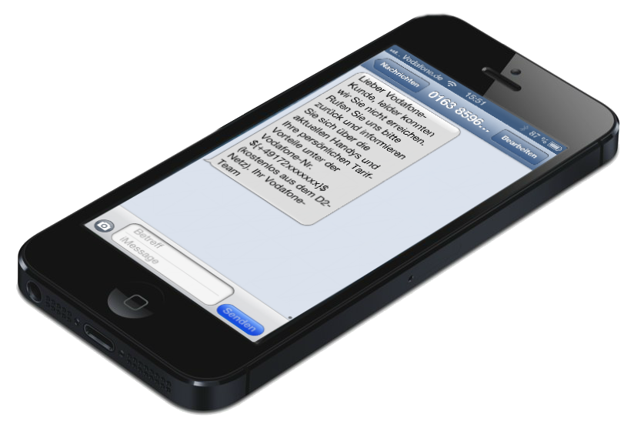
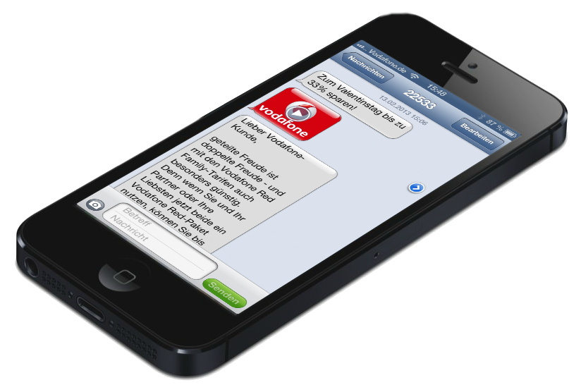


TECHNICAL SET-UP
Velti is the trusted partner for Vodafone Germany when it’s about regular customer communication via SMS/MMS/Mobile Internet
Listed Supplier / VPA (Vodafone Procurement Agreement) with VPC (Vodafone Procurement Company) in Luxembourg
Direct connection to all relevant technical interfaces:
SMS-C/MMS-C connections (MM7/MM3)
File transfer interface via SFTP
DNS entry for easy-to-integrate mobile micro sites
Campaign Management Tool (CMT) which allows comfortable campaign approval processes
Individual content optimization for all mobile phones
Any kind of personalization possible
Device database to ensure that customers receive the content each single device requires (device-based content optimization)
Delivery notification (DLR) incl. retries
Reporting and campaign evaluation

Slide 3

Process overview – Commercial
1
Campaign Enquiry
Campaign Manager
Quotation / SOW
2
Velti
3
(easybill)
RFQ via EVO Tool (BUY FROM model)
VPC
4a
PO Allocation
4b
PO Acceptance
Velti’s trading partner is VPC; OpCo contacts VPC and
VPC contacts Velti to procure goods/services
(via Ariba)
(via taulia)
4c
Create Project
Internal communication process
(via Asana)
Internal communication process
5a
Content Delivery (ideally 3 - 5 days prior to broadcast)
5b
Content Optimization
center@vodafone.com
6a
Data Delivery (ideally about 2 days prior to broadcast)
6b
Broadcast Preparation
Delivery Note
7
Accounting
Payment
(easybill)
Velti
9
Invoice
8
(easybill)
(taulia / Ariba)
Notes:
Kampagnen Anfrage vom Kunden (Telekom)
Erstellung eines KVA‘s von Velti/DWC
Bestätigung/Ablehnung des KVA‘s
?
Inhalt wird geliefert//Inhalt wird aufbereitet/verarbeitet
Daten werden geliefert (MSISDNs)//Versand wird vorbereitet
Rechnung wird gestellt
Rechnung wird bezahlt

Slide 4
Process overview – Campaign Coordination
5.1
5.2
5.3
Content delivery
Creation of
MMS Preview
Campaign set-up
(DWC Toolbox)
Preview Link
(approval process)
5a
5.4
Updating Asana Project
Notes/remarks
(non-release of Preview Link)
Feedback Vodafone
Optimizations (if required)
Optimizations (if required)
Approval
5.9
5.8
5.7
5.6
5.5
Final approval
Test broadcast
Testing & QA
Development
of Landing Page
(if integrated)
Creation of Target
Formats & videos
Test broadcast should be executed 2 days prior to launch (if requested)
In-time information of all involved departments for a better planning of the resources and compliance of timelines

Slide 5
Process overview – broadcast Preparation
6.1
6.3a
6.3b
Data editing, converting and broadcast list
creation (CSV file)
Upload Broadcast List
Template Creation
(MMS and/or SMS )
6a
Data delivery
(SFTP/Connect Direct)
6.2a
6.3c
Unique ID creation
(if requested)
Broadcast Preparation
6.2b
Data is stored
in a database
Internal broadcast
External broadcast
Live broadcast
6.5
6.4
Reporting
(approx. after 14 days)
Evaluation of DLR
(approx. after 5 days)

Slide 6
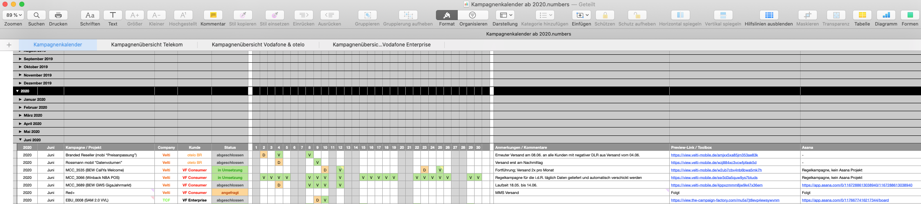
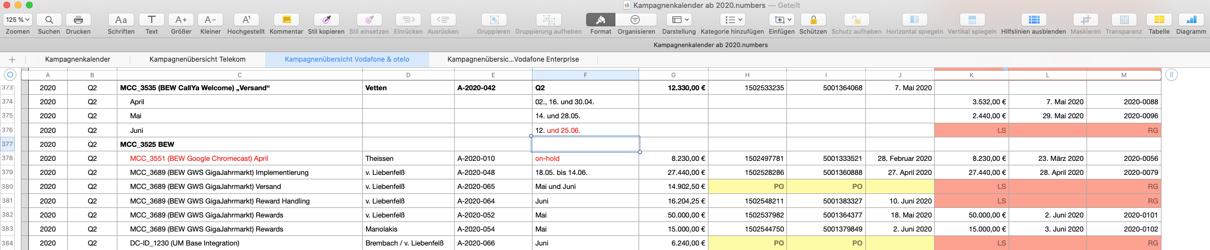
Organizational information
All campaigns are listed in the Campaign Calendar on a monthly basis
iCloud Drive/Numbers/Kampagnenkalender ab 2020.numbers
Beyond that, the commercial status of each single campaign is listed in the Campaign Overview
iCloud Drive/Numbers/Kampagnenkalender ab 2020.numbers

Slide 7
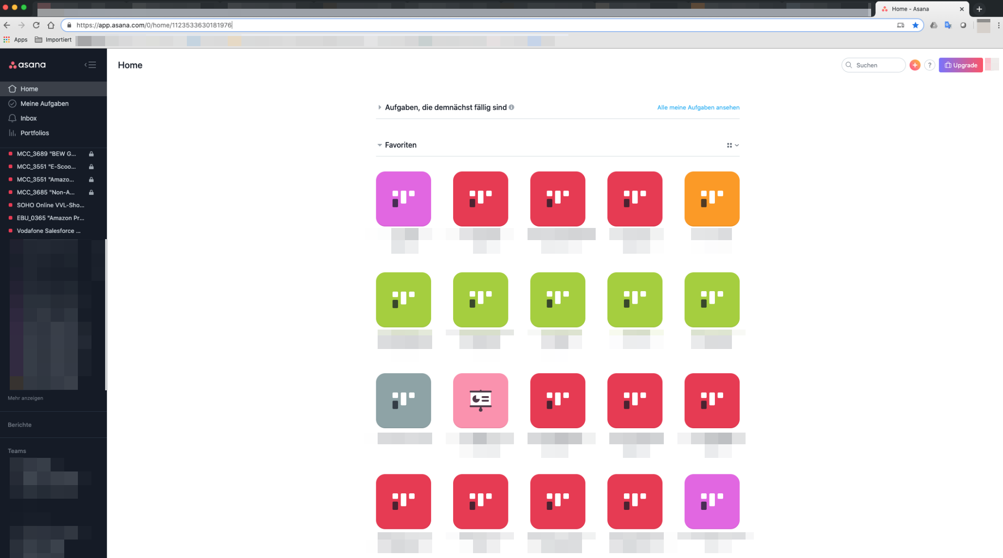
Organizational information
Every campaign/project will be created in Asana (project management tool)
https://app.asana.com/-/login

Slide 8
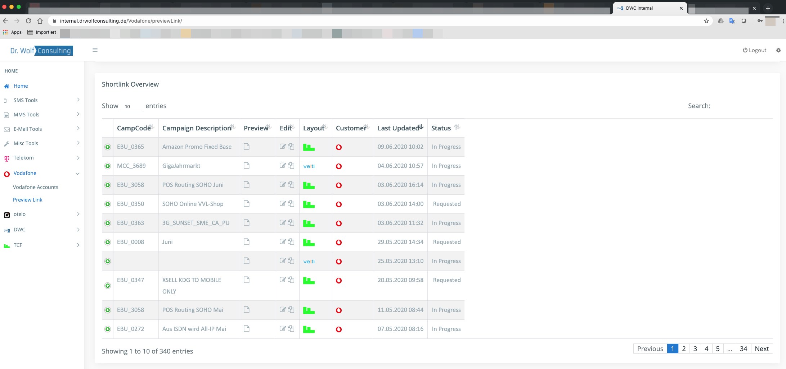
Organizational information
Additionally, every campaign/project will be created in our Toolbox (Preview Link for approval process)
https://internal.drwolfconsulting.de/login/

